Slide 1


DOGGO DREAMS

Slide 2
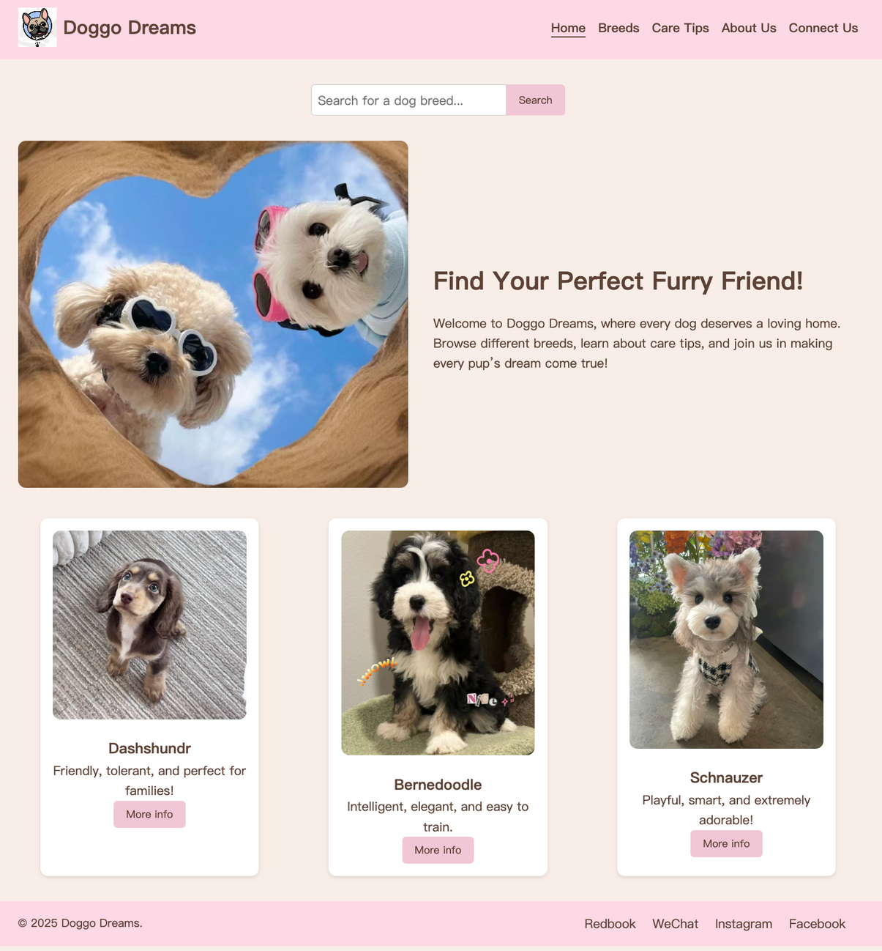

HOME PAGE
• Semantic Tags:
Utilizes header, main, and footer
• Responsive Layout:
Achieved with Flexbox and media queries
• Visuals & Interaction:
Includes colors, rounded corners,
animations, and a slight zoom on hover
• Functional Elements:
Provides a search bar, info cards,
footer copyright, and social links

Slide 3





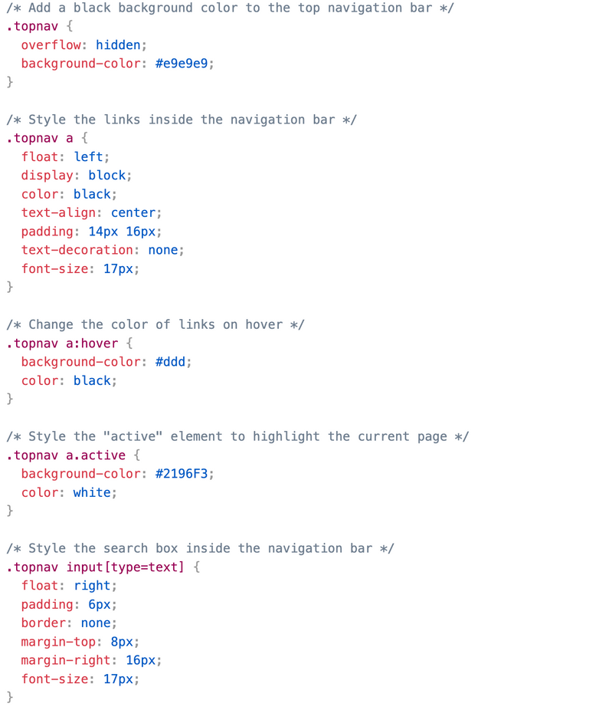
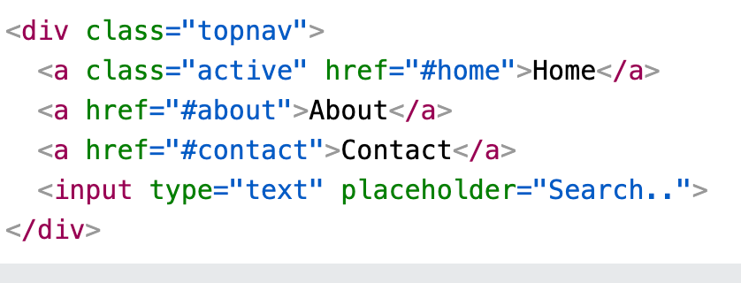
Step 1: HTML
Step 2: CSS
SEARCH BAR
https://www.w3schools.com/howto/howto_css_searchbar.asp

Slide 4

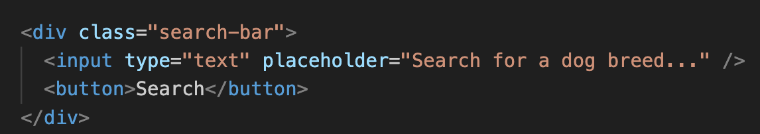
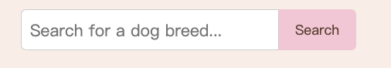

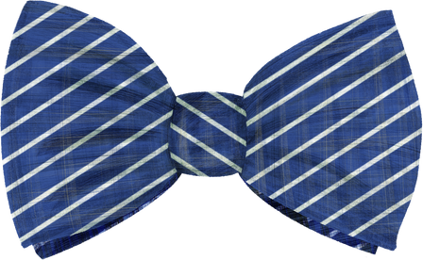
SEARCH BAR -HTML
<div>: a container holding all the search-related elements
<input>: where users type keywords
the placeholder: gives a hint
<button>: clicked to search
implement & real search: JavaScript or a backend script

Slide 5
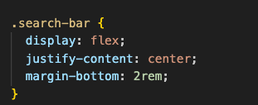

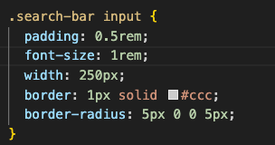
Search Bar- CSS
search-bar
-input, button same line
-Centers them horizontally
-Adds vertical spacing
before the next section
.Search-Bar input
-creates internal spacing
-sets the text size
-Restricts the input width
-Adds a light gray border
-only rounda the left coners

Slide 6

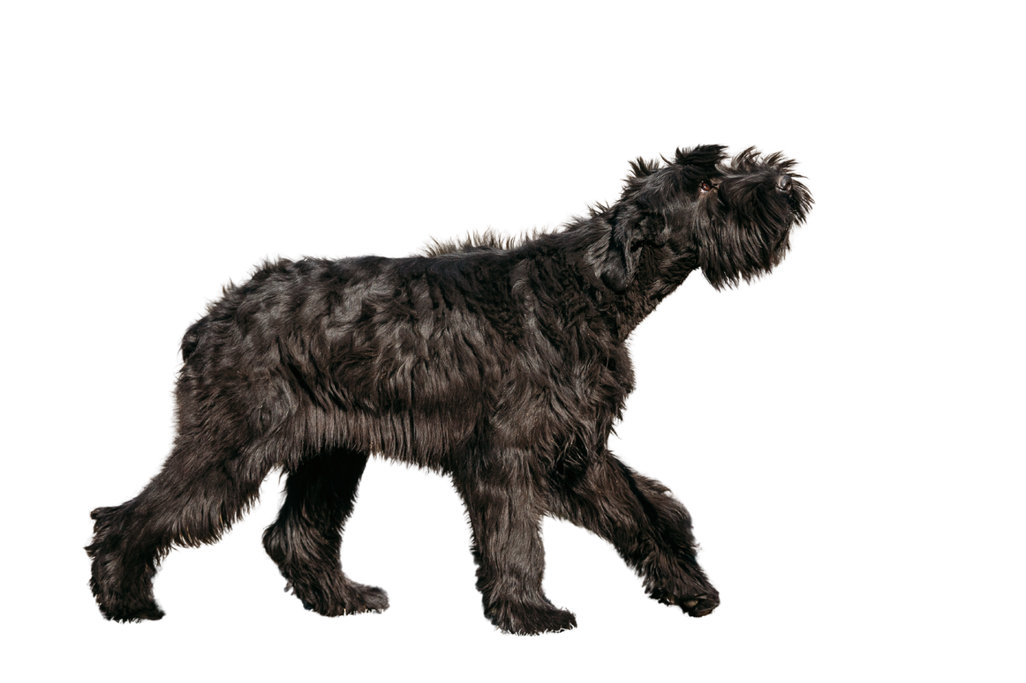
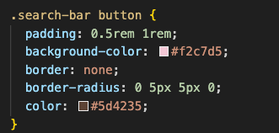
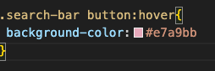


SEARCH BAR -CSS
.Search-bar
button:hover
-change the background to a deeper pink on hover
.Search-bar button
-Adds internal spacing for easier clicking
-Applies pink background
-Removes default button border
-Rounds the right corners only
-set text to dark brown shade

Slide 7
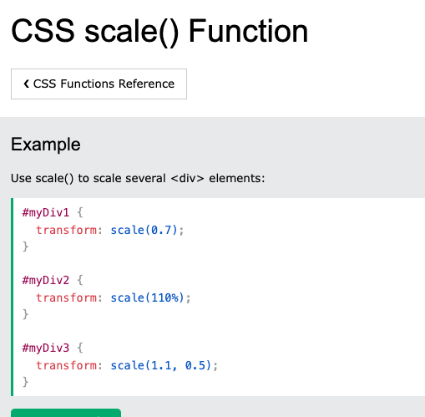

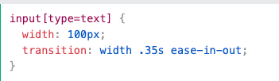
card effect
https://www.w3schools.com/cssref/func_scale.php
https://www.w3schools.com/cssref/css3_pr_transition.php

Slide 8
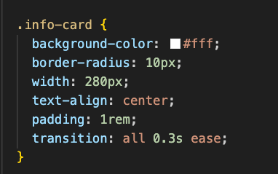





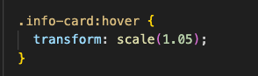



Who we are?
card effect
Briefly elaborate on what you want to discuss.
Transform： scale（1.05）
（Zoom in & Zoom out)
transition： all 0.3s ease
(animation smooth)

Slide 9
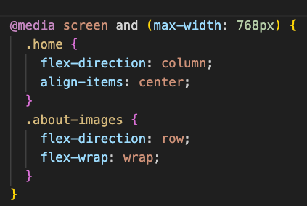
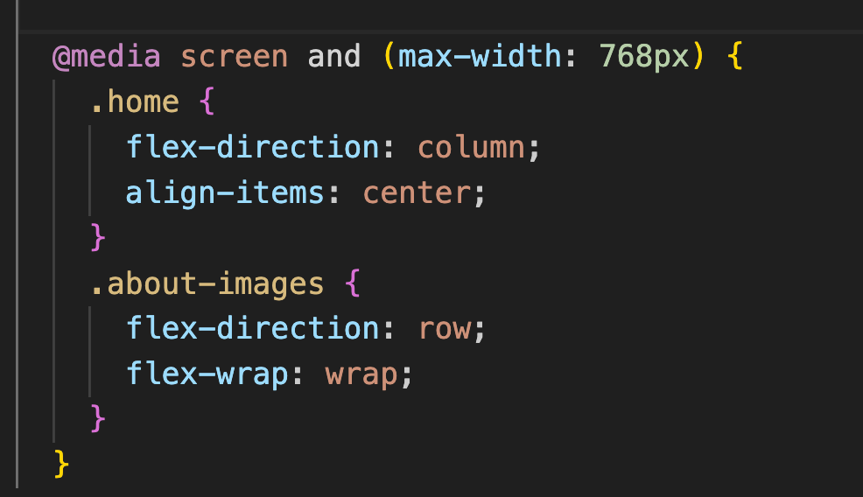
MEDIA QUERY

Slide 10

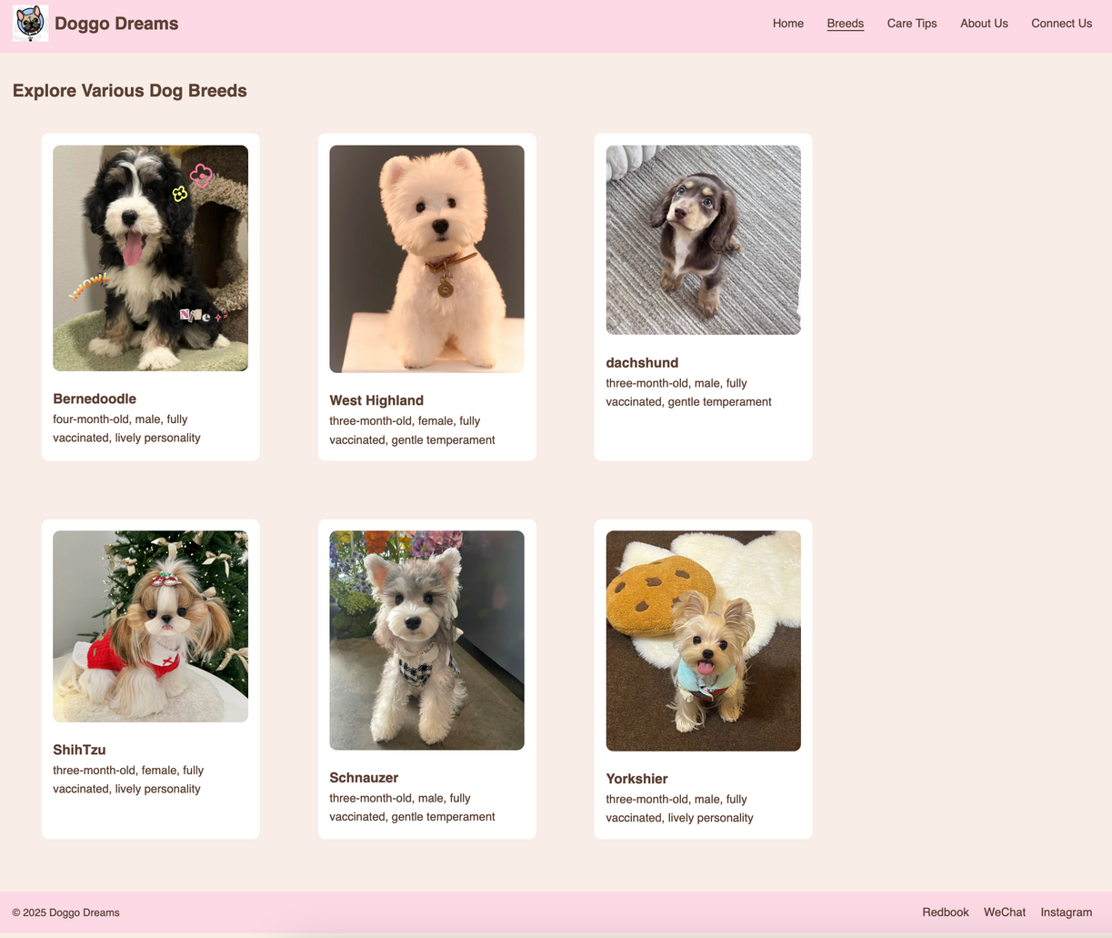
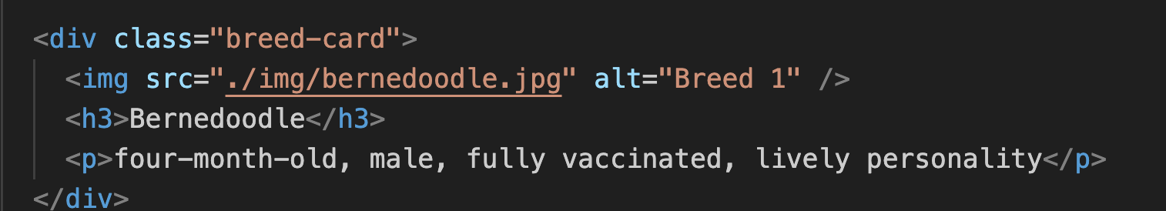
BREED PAGE
Service One

Slide 11
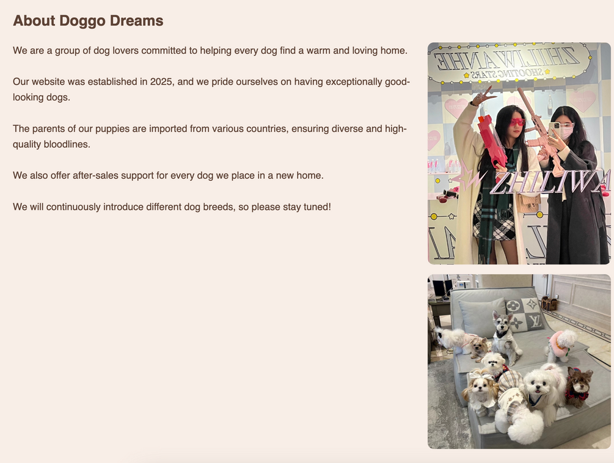
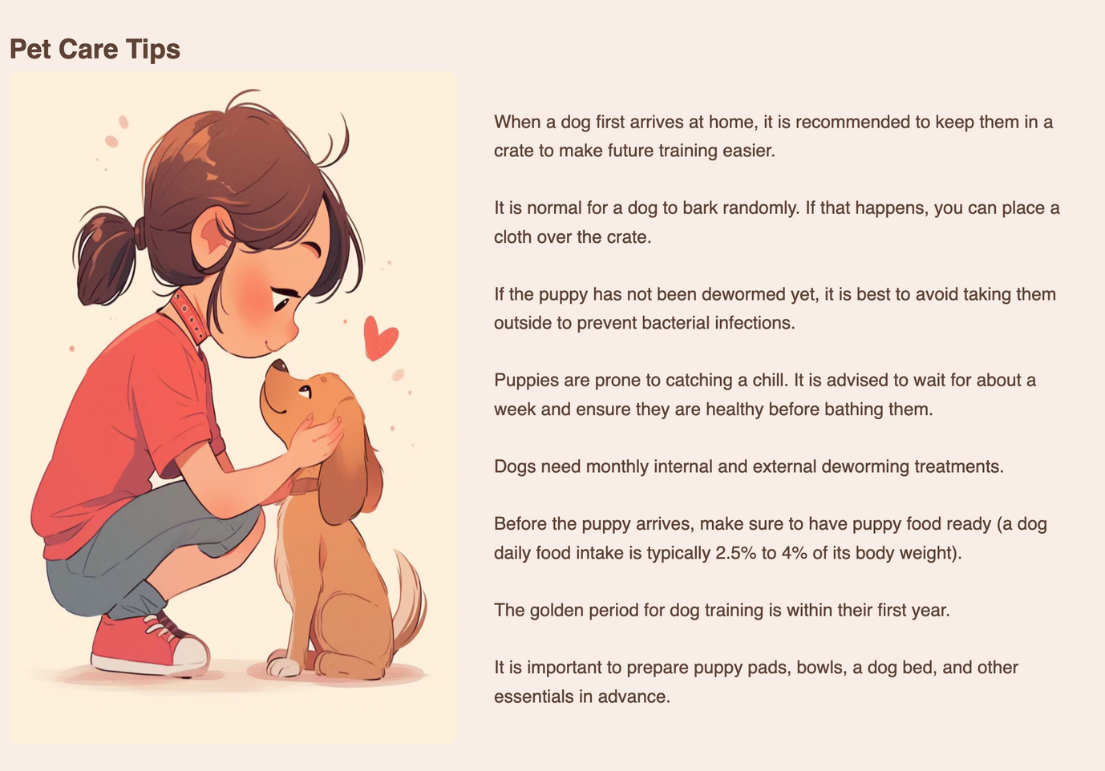

CONNECT US/ABOYT US CARE TIPS

Slide 12
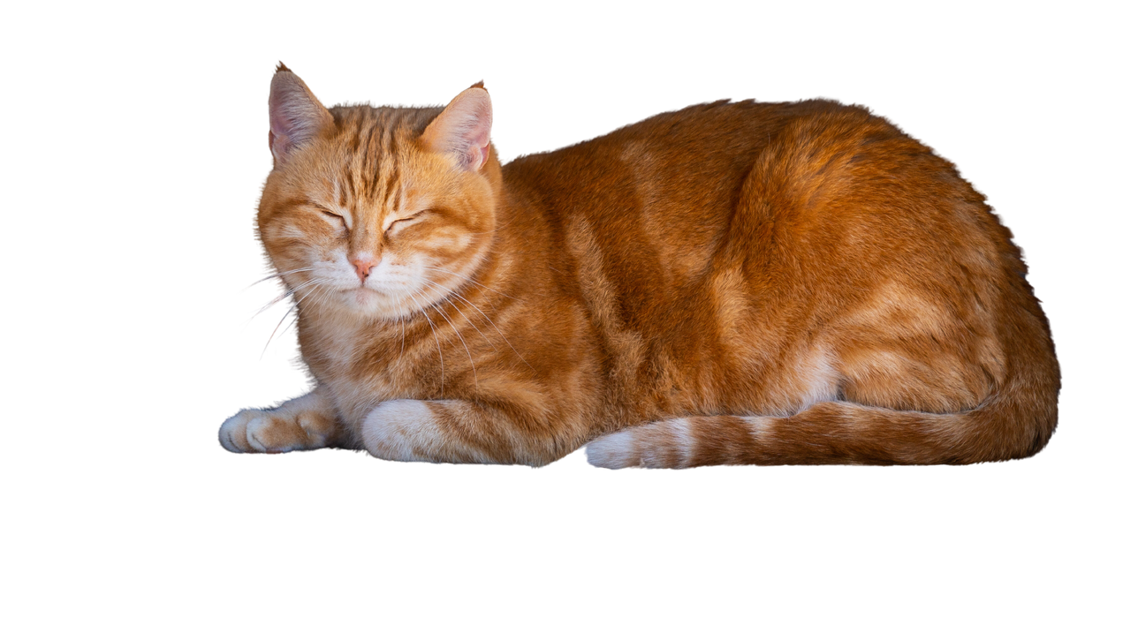

Next step
1.
Enhance functionality& interactivity
2. Online Ordering / purchasing Process
3. Expanded Datebase & search
4. Social Media & ueser interaction

Slide 13





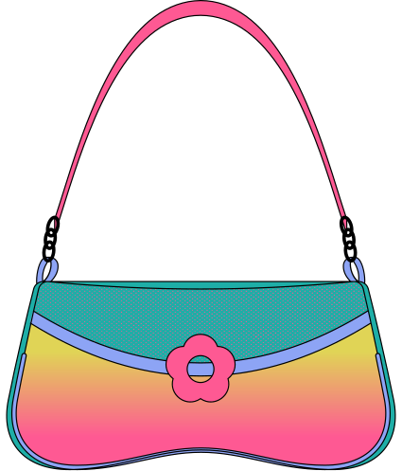
QUESTION
When improving the mobile experience, what important points or common details are often missed and need special attention?

